Slide 1
MINI PROJECT
Name | Sneha V Shet Anushree S G Sufiya Taranum
Registration Numbers | 241058017 | 241058028 | 241058038
Branch | Big Data Analytics
Project Title | Streamlining Object Detection using Tensorflow Keras and AWS.
Guide | Dr. Prathviraj N

Slide 2
CONTENTS
Introduction
Literature Review
Objective
Operational Flow
Functional Requirements
Implementation
Work Done
References

Slide 3
INTRODUCTION
Object detection is a fundamental task in the field of computer vision, involves identifying and classifying objects within images or videos. From autonomous vehicles to medical imaging, object detection plays a crucial role in various industries.
In modern machine learning projects, the complexity of managing data, experiments, and model deployment grows significantly.
Traditional approaches often struggle with challenges such as handling large datasets, optimizing model training, and tracking experiments in a reproducible manner.
This project aims to address these challenges by leveraging one powerful tool: Tensorflow.

Slide 4
Tensorflow simplifies the management of data science workflows, allowing teams to build and iterate on models more efficiently.
Google provides the cloud infrastructure necessary to scale object detection models, ensuring that training and inference can be performed on large datasets with high computational demands.
By integrating these technologies, the project offers a streamlined, end-to-end solution for object detection.
This approach can be done in cloud platforms to improves collaboration, scalability, and experiment management, resulting in faster development cycles and more reliable deployments in real-world applications.

Slide 5
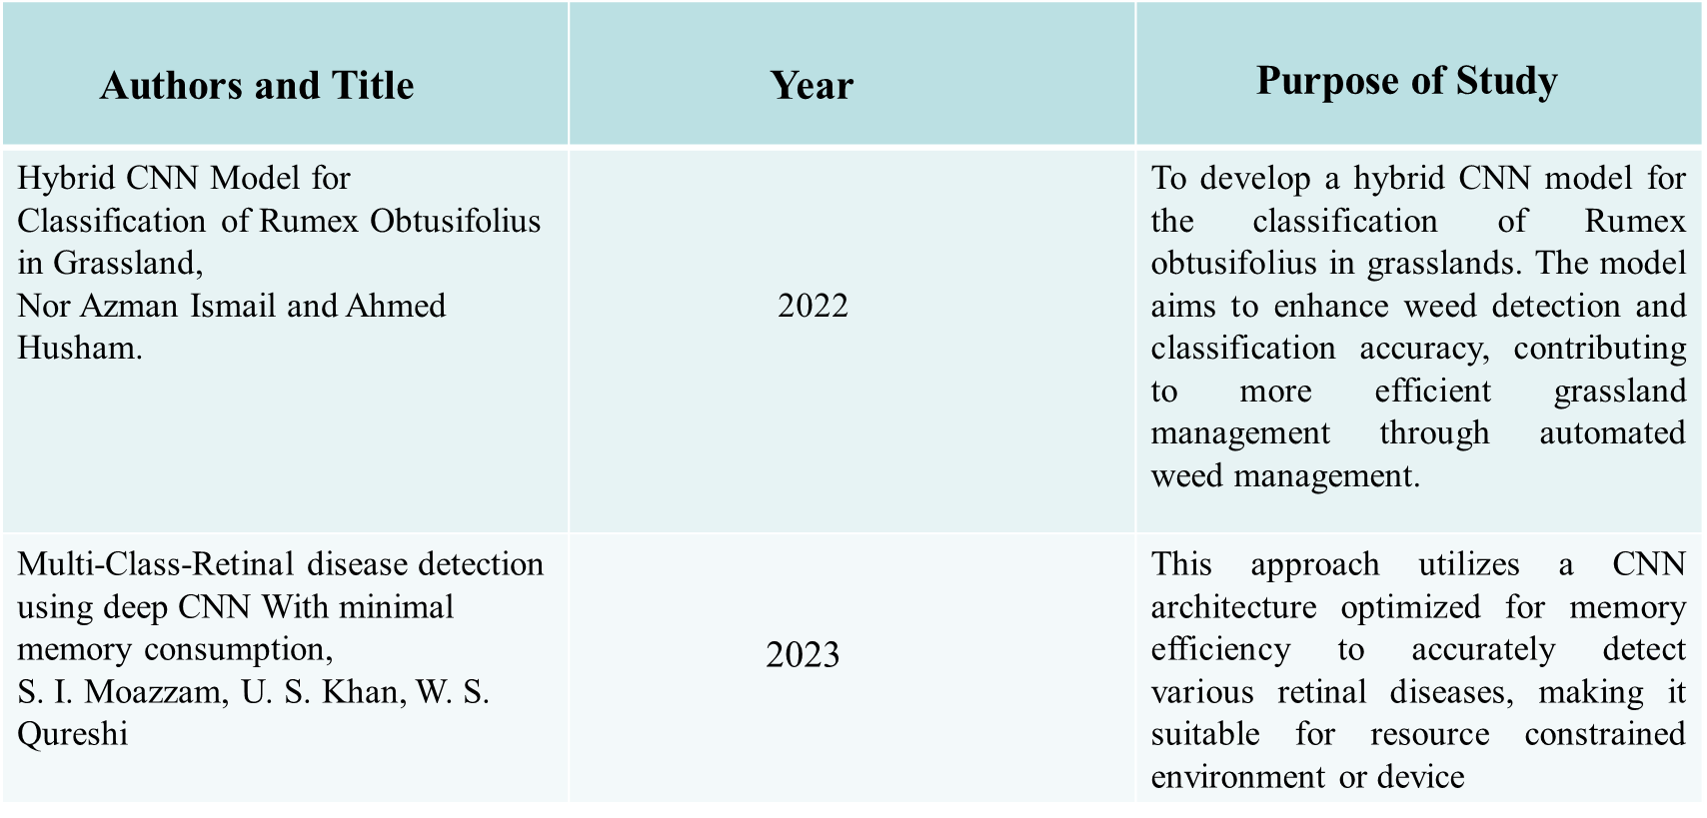
LITERATURE REVIEW

Slide 6
OBJECTIVE
The integration of Tensorflow, Keras and AWS in object detection projects is used to:
Enhance efficiency and automation through streamlined workflows and scalable resources.
Manage large-scale computations and storage effectively with AWS.
Track, analyze, and optimize experiments systematically.
Ensure reproducibility, collaboration, and robust performance.

Slide 7
OPERATIONAL FLOW
Tensorflow
Start-up
Transform Data
Keras
Train Model
AWS
Evaluate Model
AWS Sagemaker
Deploy Model
Fig 1: Overview of project flow

Slide 8
FUNCTIONAL REQUIREMENTS
Software Requirements
OS: Windows
Python: Version 3.7+
Libraries: TensorFlow 2.x, Keras, OpenCV, NumPy, Matplotlib, TensorFlow Lite
Cloud Platforms: GCP, AWS
Functional Requirements
1.Model Selection and customization
2.Input Data Handling
3.Training Framework
4.Model Evaluation and Interface optimization
5.Deployment
6.User Interface

Slide 9
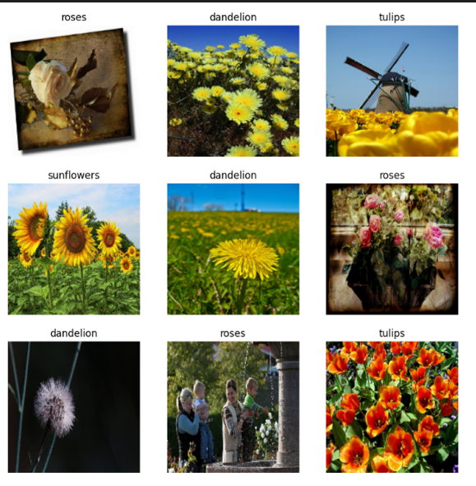
IMPLEMENTATION
Flower Dataset –
3760 images with 5 different types of Flowers.
Training Data –
80% of Total data will be 2936 images for training.
Testing Data –
20% of total data will be 734 files for validation.
Fig 2 :Visualizing the first 9 images using MatPlotLib

Slide 10
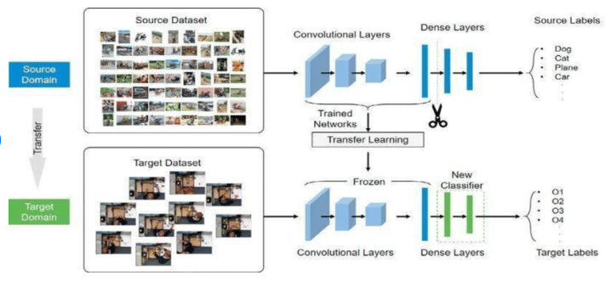
IMPLEMENTATION
Fig 3: Image Classification with Tensorflow

Slide 11
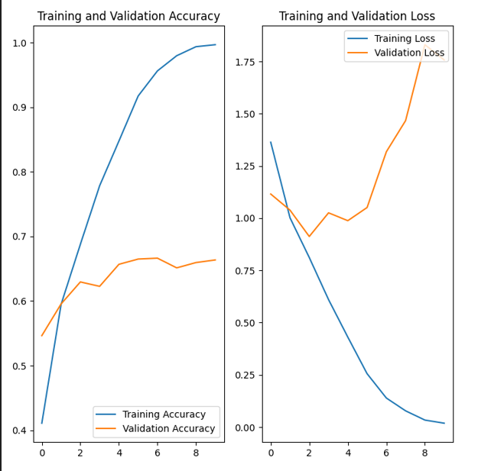
WORK DONE
1. The plots show that training accuracy and validation accuracy are off by large margins, and the model has achieved only around 60% accuracy on the validation set
2. When there are a small number of training examples, the model sometimes learns from noises or unwanted details from training examples—to an extent that it negatively impacts the performance of the model on new examples. This phenomenon is known as overfitting. It means that the model will have a difficult time generalizing on a new dataset.
Fig:4 Training and validation Accuracy and Loss
(Overfitting Model)

Slide 12
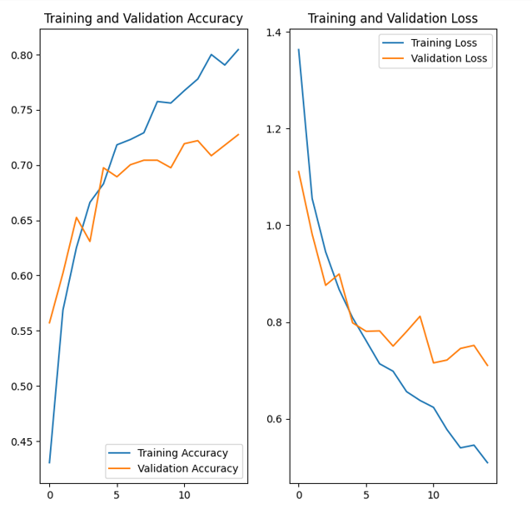
WORK DONE
1. Data augmentation takes the approach of generating additional training data from your existing examples by augmenting them using random transformations that yield believable-looking images. This helps expose the model to more aspects of the data and generalize better.
2. Tf.keras.layers.ramdomFlip , tf.keras.layers.RamdomRotations and RandomZoom are some of built in Keras API functions to be used.
Fig 5 : Training and Validation Accuracy and Loss after Data Augmentation(Good Fit )

Slide 13


WORK DONE
Predict on New Data:
Using model to classify an image that wasn't included in the training or validation sets.
Results:
Fig 6: Testing image

Slide 14
References
[1] C. Huyen, Introduction to Machine Learning Interviews (2021), Self-published
[2] V. Tuulos, Effective Data Science Infrastructure (2022), Manning Publications Co.
https://towardsdatascience.com/streamlining-object-detection-with-metaflow-aws-and-weights-biases-b44a14cb2e11
https://github.com/EdIzaguirre/plant-object-detection
https://www.tensorflow.org/tutorials/images/classification

Slide 15
THANK YOU

